Slide 1

Capstone Project
Mobile Price Range Prediction
BY –
Prince Jain
Rishabh Patidar
Vikash Shrivas

Slide 2

Content
Problem Statement / Description
Introduction
Data preparation & cleaning
EDA and Data Processing
ML Model – Classification
K-Nearest Neighbors.
Support Vector Machines.
Decision Tree Classifiers/Random Forests.
Naive Bayes.
Logistic Regression
Conclusion

Slide 3

Problem Statement
Companies in the mobile phone market want to understand sales data and factors that drive prices. The objective is to find out some relation between features of a mobile phone and its selling price. In this problem, we do not have to predict the actual price but a price range indicating how high the price is.

Slide 4

Data Description
Data Description -
Battery_power - Total energy a battery can store in one time measured in mAh
Blue - Has bluetooth or not
Clock_speed - speed at which microprocessor executes instructions
Dual_sim - Has dual sim support or not
Fc - Front Camera mega pixels
Four_g - Has 4G or not
Int_memory - Internal Memory in Gigabytes
M_dep - Mobile Depth in cm
Mobile_wt - Weight of mobile phone
N_cores - Number of cores of processor
Pc - Primary Camera mega pixels
Px_height - Pixel Resolution Height
Px_width - Pixel Resolution Width
Ram - Random Access Memory in Mega Bytes
Sc_h - Screen Height of mobile in cm
Sc_w - Screen Width of mobile in cm
Talk_time - longest time that a single battery charge will last when you are
Three_g - Has 3G or not
Touch_screen - Has touch screen or not
Wifi - Has wifi or not
Price_range - This is the target variable with value of 0(low cost), 1(medium cost),2(high cost) and 3(very high cost).

Slide 5
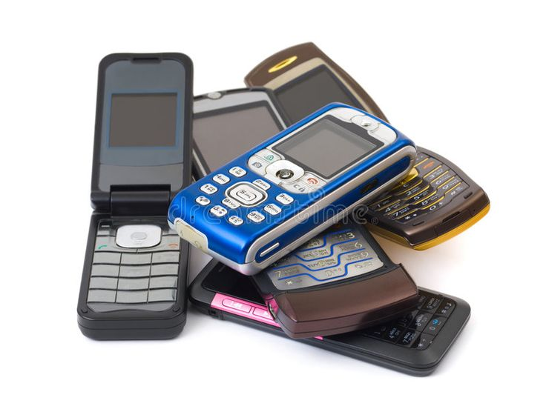
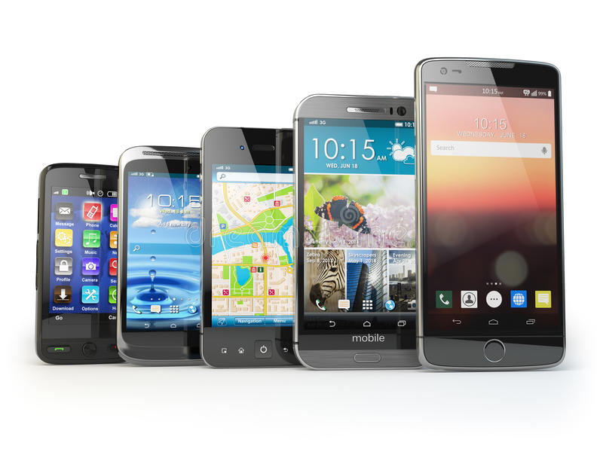
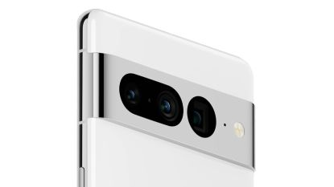
Introduction
Mobile phones come in all sorts of prices, features, specifications and all. Price estimation and prediction is an important part of consumer strategy. Deciding on the correct price of a product is very important for the market success of a product. A new product that has to be launched, must have the correct price so that consumers find it appropriate to buy the product.
The data contains information regarding mobile phone features, specifications etc and their price range. The various features and information can be used to predict the price range of a mobile phone.
In the competitive mobile phone market companies want to understand sales data of mobile phones and the factors which drive the prices. The objective is to find out some relation between the features of a mobile phone(eg:- RAM, Internal Memory, etc) and its selling price. In this problem, we do not have to predict the actual price but a price range indicating how high the price is.

Slide 6
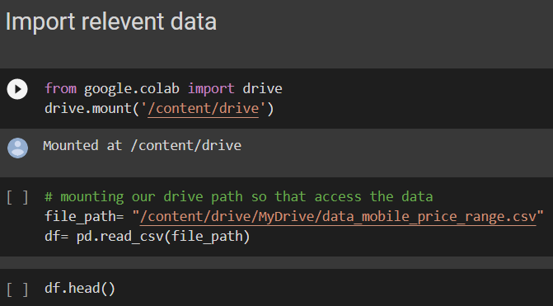
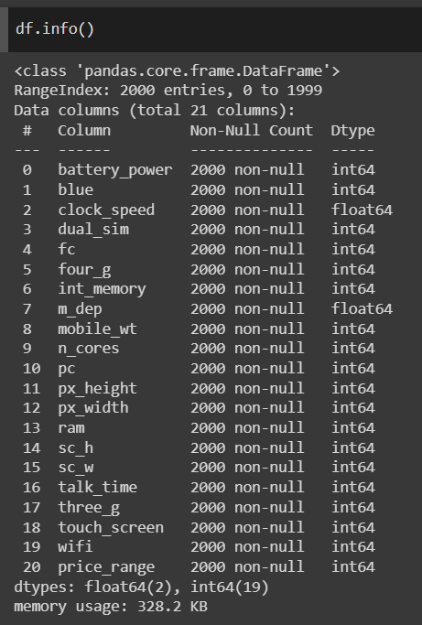
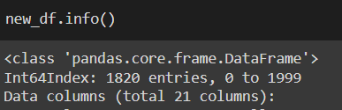

Data preparation & cleaning
Now, we remove the data points with missing data.
Like :- data_f = df[df['sc_w'] != 0]
After removing the missing values the data consist of 21 columns and 1820 rows
Here we see that the data consist of 21 column and 2000 rows.

Slide 7
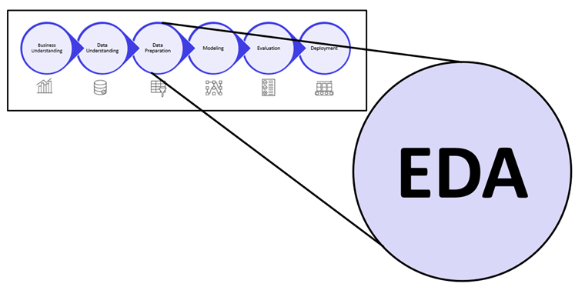

EDA and Data Processing

Slide 8
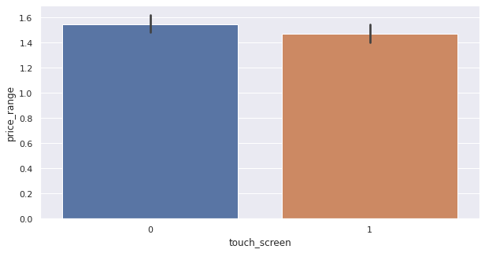
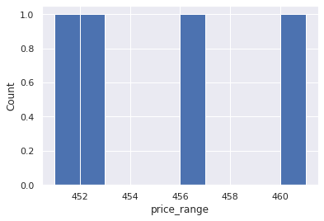
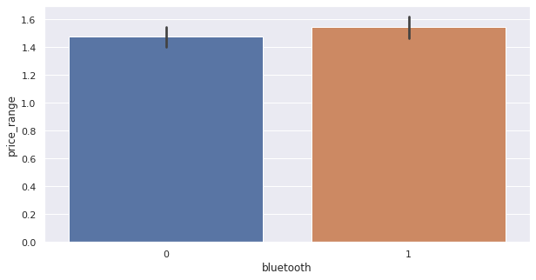
Price Segments
Screen types
We see that half of all mobile phones have touch-screen features and the other half do not.
Bluetooth
The survey found that half of the devices have Bluetooth, while half do not.
There are four price ranges for mobile phones. The number of elements is almost identical between the categories.

Slide 9
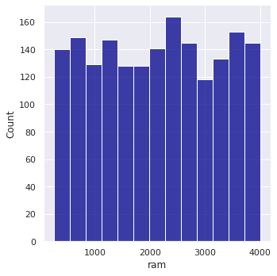
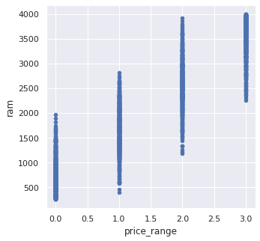
Random Access Memory in Mega Bytes
RAM
Ram varies from 256 MB to 4Gb, as shown in the chart above.
In this scatter chart we see that there are four price segments with increased ram and increased price of mobile phones.

Slide 10
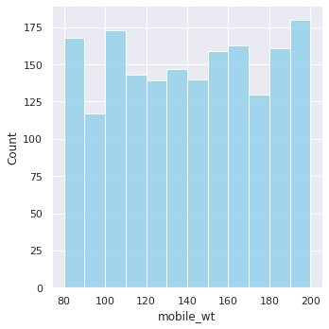
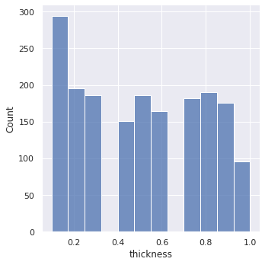
Mobile weight
Thickness(in cm).
The data show that the average weight of mobile phones is over 80 grams and their maximum weight is less than 200 grams.
A few mobiles are very thin and some are almost a centimeter thick.

Slide 11
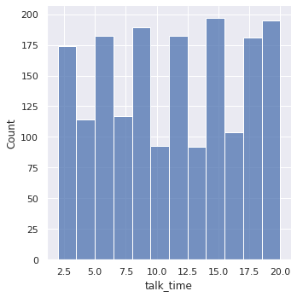
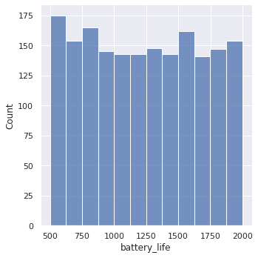
Talktime
Battery in MAH
The bar chart above shows the range of talk time among the phones. The lowest range is 2.5 hours, and the longest is 20 hours.
The battery life of a mobile phone typically ranges from 500 to 2000 mAh.The most frequently purchased mobile phone with a 500 mAh battery is the most popular.

Slide 12
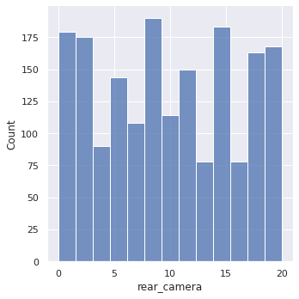
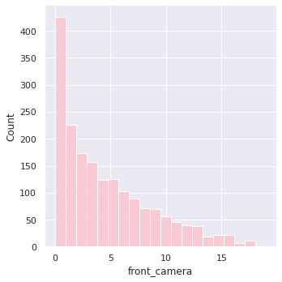
PC (Primary camera Megapixels)
Front Camera
In this bar chart, we found that some mobile cameras do not contain a camera, and show zero. We also saw that the maximum mobile camera is 8MP and after it is 13MP.
The majority of phones do not contain a front-facing camera, and the maximum number of phones currently on sale contains a 2mp camera.

Slide 13
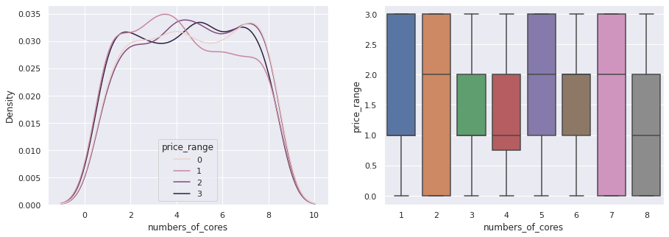
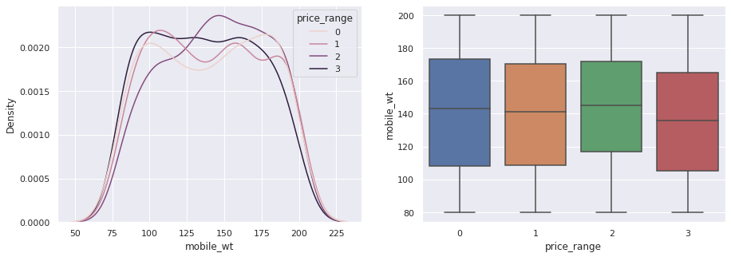

This discussion will focus on some of the differences between parameters and prices.
Discuss various parameters and their relationship to price
Numbers of core vs price
Weight vs price
The above chart shows the number of core 2 and 7 available in the price range 0 to 3, whereas we saw that the number of course 8 is not available at a high price, and core number 1 is not available at a low price.
It is observed that the cost of a phone is directly proportional to its weight. The price of a cell phone rises as the weight of the phone decreases.

Slide 14
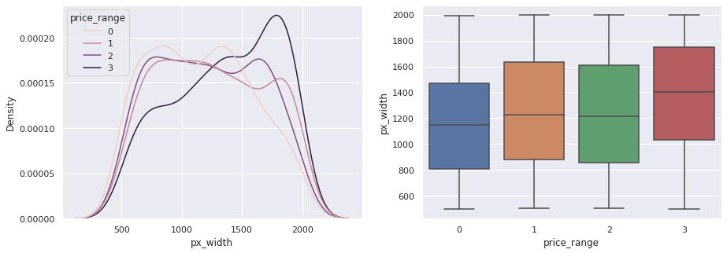
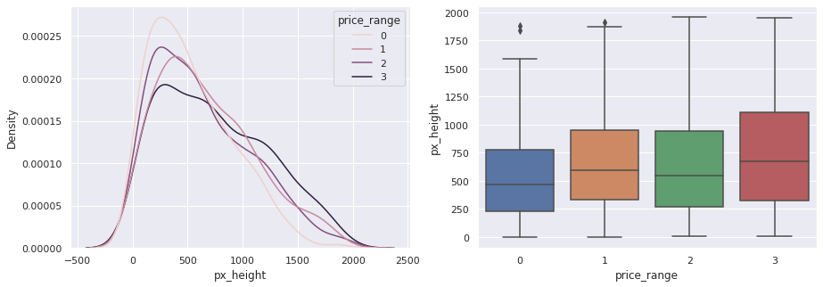
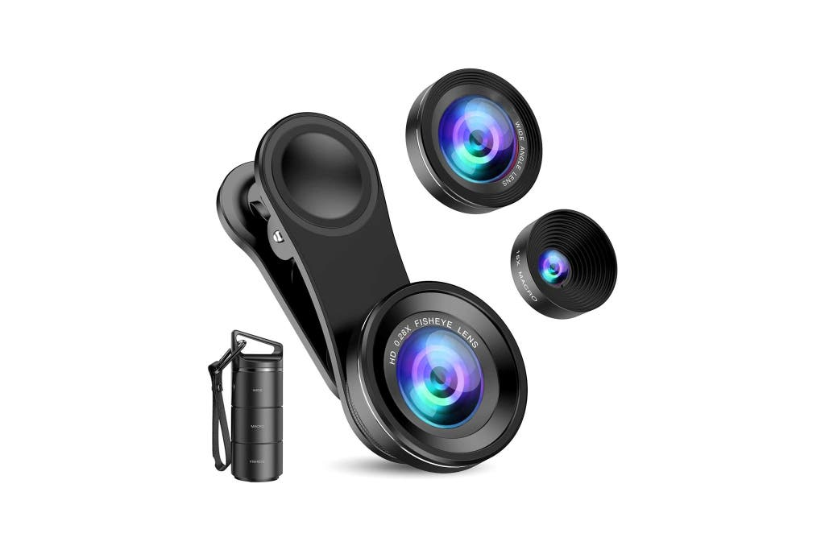
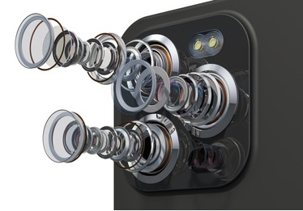
Pixel Resolution Width
Pixel Resolution height
As we move from Low cost to Very high cost, the pixel widths of mobiles do not increase in absolute terms. However, mobile with 'Medium cost' and 'High cost' has almost equal pixel widths so we can say that it would be a driving factor in deciding price_range.
Pixel height, as we move from low cost to very high cost, remains relatively consistent.

Slide 15
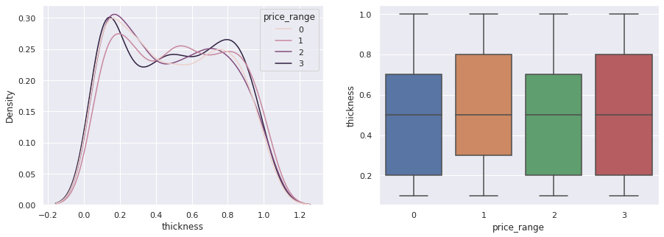
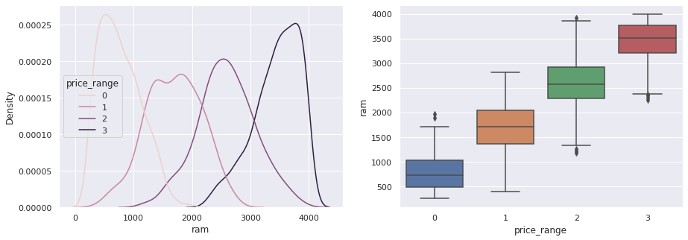


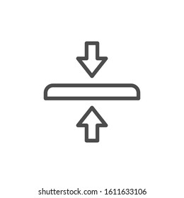
Thickness vs price
Ram vs price
Thick phones are available at the lowest price. The thickness of mobiles ranges from 0.2 cm to almost one centimeter thick. The cost of thick phones is low or may be high.
The higher the RAM, the more expensive a smartphone is likely to be.
RAM ∝ MOBILE PRICE

Slide 16
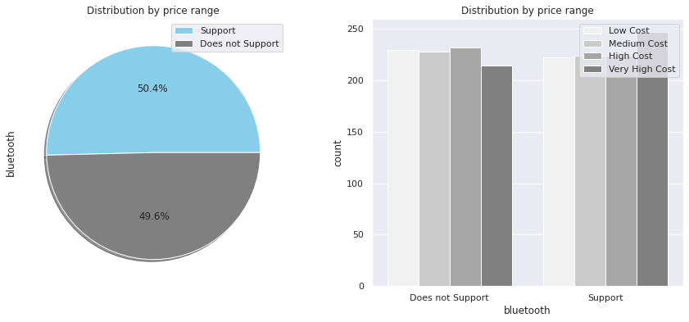
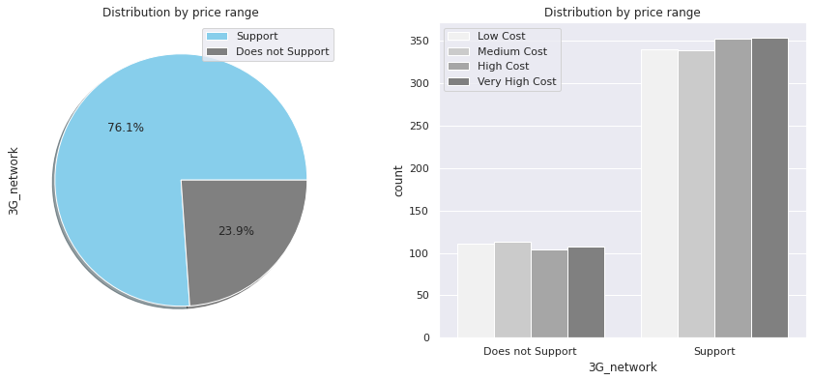
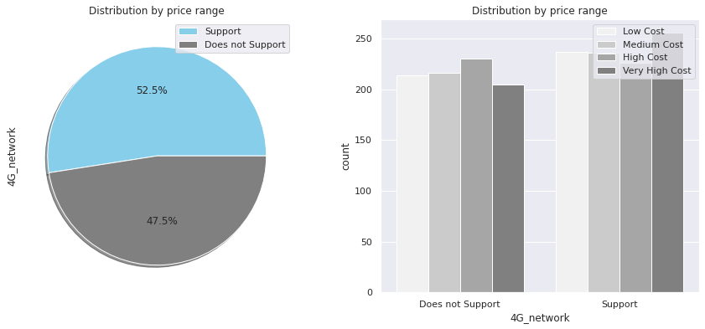
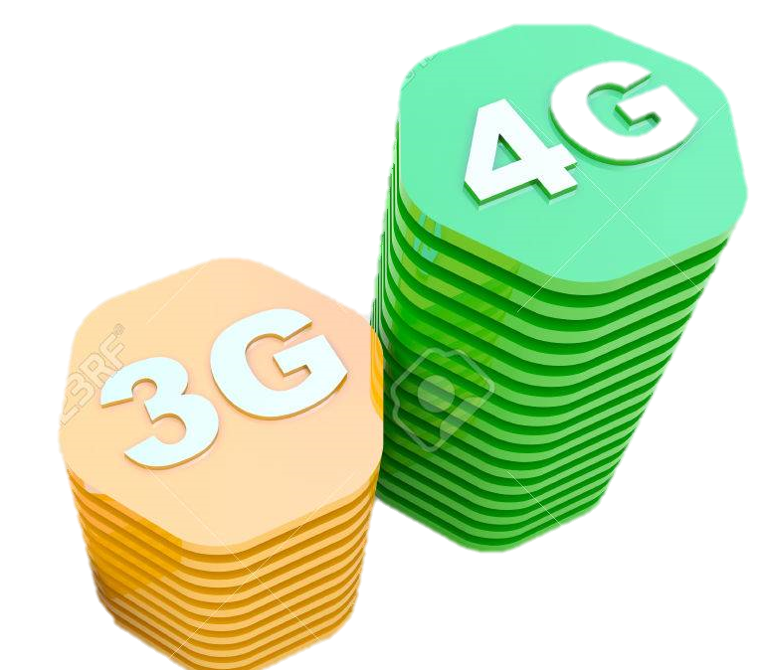

Connectivity
A study by Mobile Price Range Prediction has shown that 76.1% of mobile phone users have 3G connectivity, while 23.9% do not support 3G. There are 52.5% of mobile phones with 4G connectivity and 43.5% do not support 4G. According to TRAI data, 50.4% of the users have Bluetooth connectivity and 49.6% do not have it. All these mobile phones are expensive, though.

Slide 17
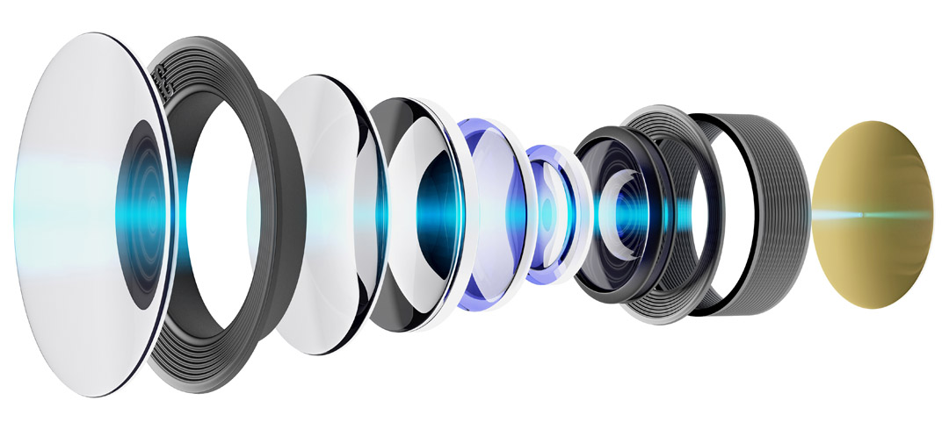
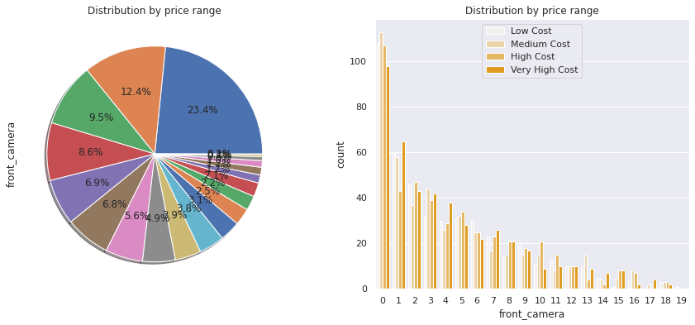
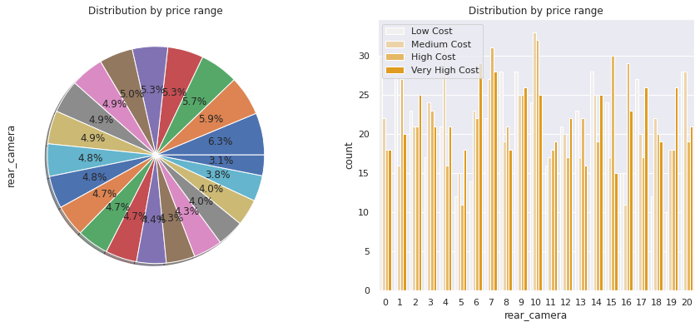
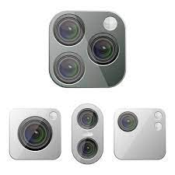
Camera and Price
In this distribution, we can see that 23.4% of mobiles do not have a front camera. This is the highest percentage and there are 19 types of front cameras.
If we look at rear cameras, there are 20 different models, with a maximum percentage of 6.3%. The price range for these mobiles is from 0 to 4

Slide 18
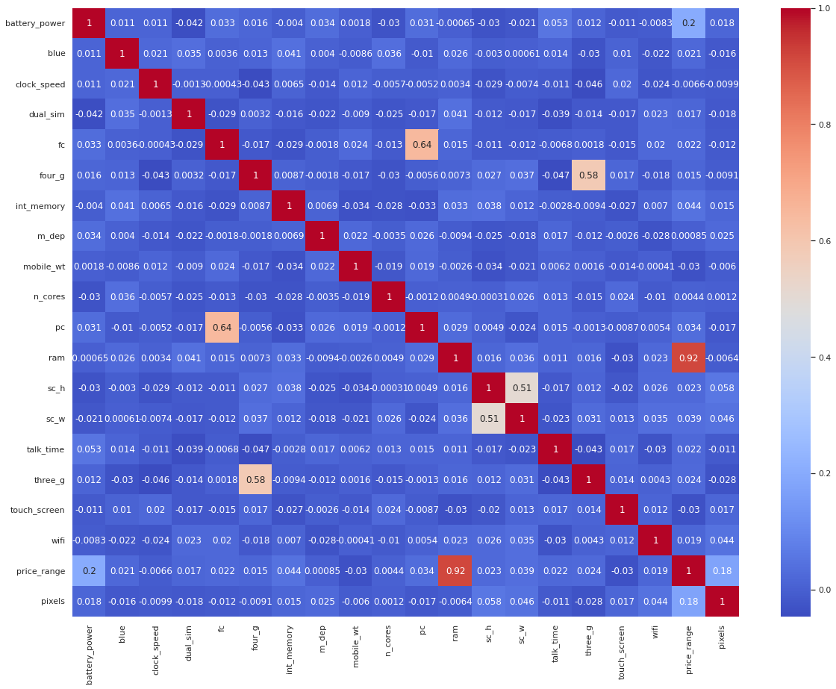
Heat map
RAM and price_range are highly correlated, as expected. This signifies that RAM will play a significant role in predicting the price range of a smartphone. There is some collinearity between feature pairs ('pc', 'fc') and ('px_width', 'px_height'). Both correlations are justified because there are good chances that if front camera quality is good, back camera quality would be good too. Additionally, if px_height increases, pixel width also increases, which means overall screen pixels. We can replace these two features with one feature: Front Camera megapixels and Primary Camera megapixels are different entities despite being correlated; therefore we will keep them as they are for now.

Slide 19

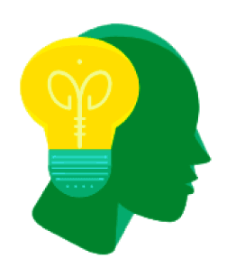

Machine Learning Model – Classification
Types of Classifiers Used :
K-Nearest Neighbors.
Support Vector Machines.
Decision Tree Classifiers/Random Forests.
Naive Bayes.
Logistic Regression.

Slide 20
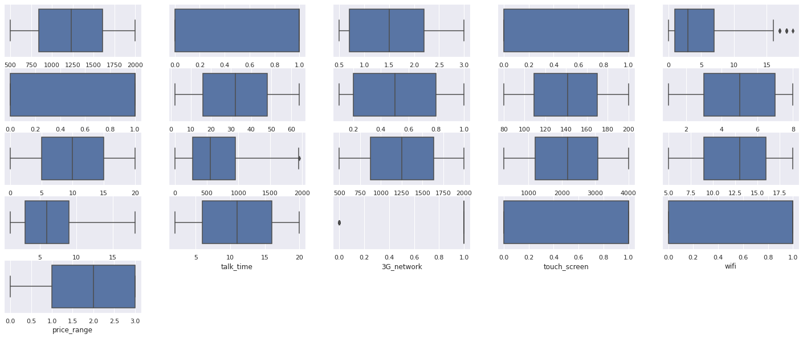
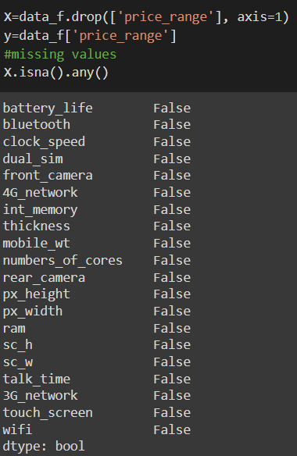
looking for outliers using box plot
missing values or missing data

Slide 21

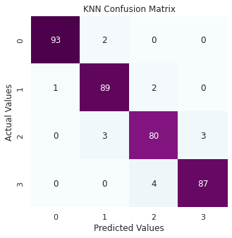
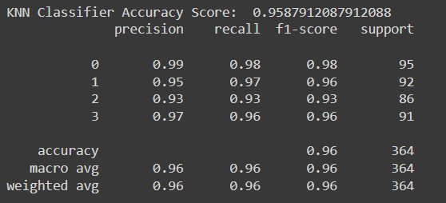
K-Nearest Neighbors
whereas the kNN method was to produce a accuracy score is 95.87 %
Accuracy_ Score : 95.87%

Slide 22
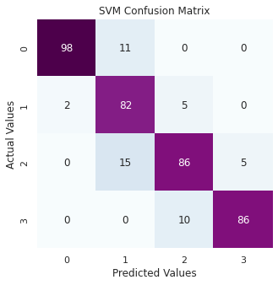
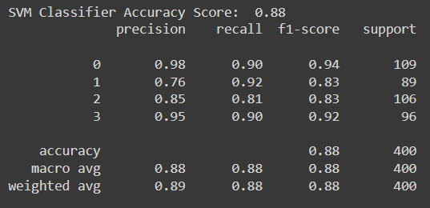

Support Vector Machines
Accuracy_ Score : 88%
The linear SVM model had a classification accuracy of 88% with those transcript variables, four fewer variables than logistic regression

Slide 23
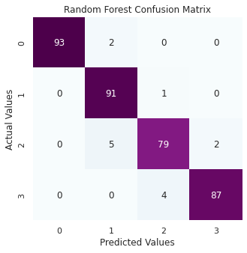
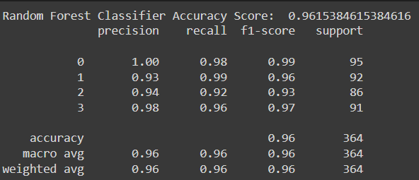

Random Forests
A random forest is built on a variety of decision trees. Every decision tree is made up of nodes that represent decisions, leaf nodes and a root node. The leaf nodes of each tree represent the decisions in the decision tree, and the root node represents the final result of that decision tree. The final product can be determined using a majority-voting procedure. Let us now implement our random forest algorithm.
Accuracy_ Score : 96.15%

Slide 24
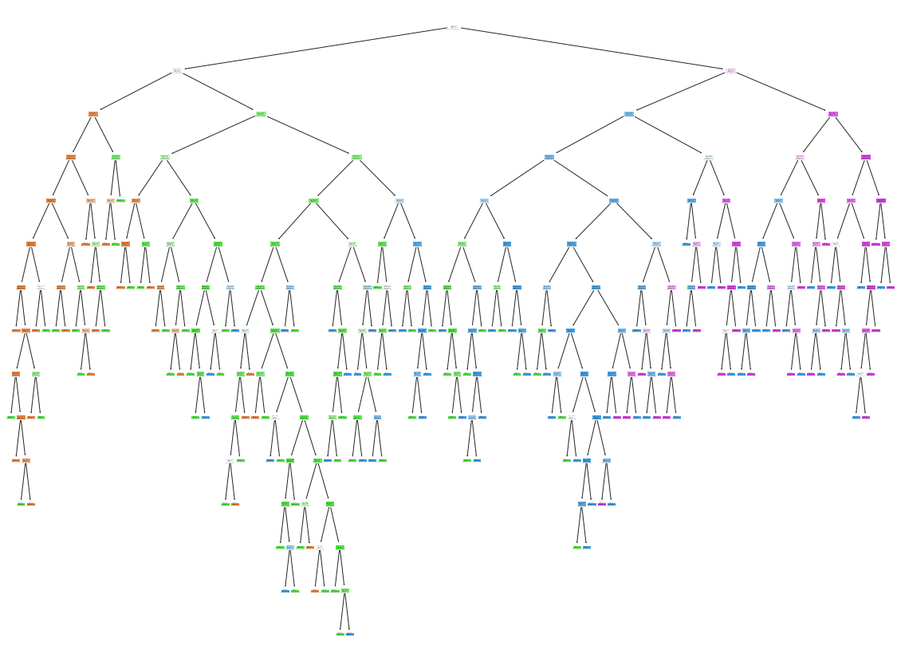
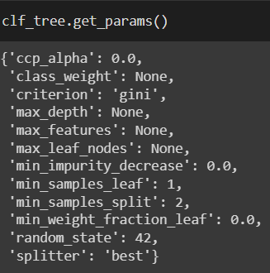
Decision Tree Classifiers
The model overfit because the training dataset accuracy was 100% for all 5 different folds of the cross validation, while the average testing dataset accuracy was 83.14%. An 83.14% accuracy for the testing set is pretty good, but I believe this model could do better. I will try to tune this model by adding more layers with smaller number of neurons per layer.
clf_tree.get_depth()= 14
clf_tree.get_n_leaves() =154

Slide 25


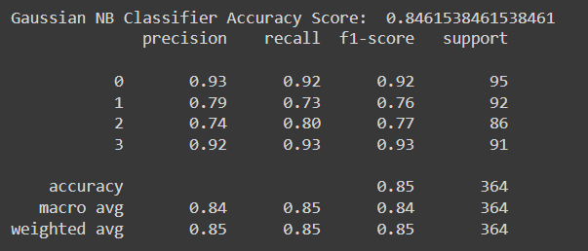
Naive Bayes
By comparing the actual and predicted values of the Naïve Bayes method, an accuracy of 84.61% was achieved.
Accuracy_ Score : 84.61%

Slide 26
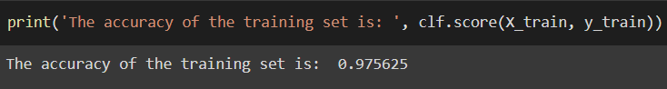

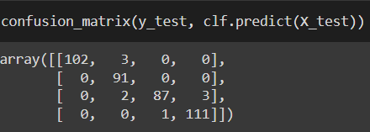
Logistic Regression
Overall, some good baseline statistics. I will use KFold Cross Validation to ensure that the model is not overfitting and get a more realistic accuracy for the training and testing datasets. For future scenarios, I will use 5 folds for KFold Cross Validation. Note that StratifiedKFold Cross Validation isn't needed as the price_range data is spread out (equal number of 0, 1, 2, and 3)
Train_accuracy : 97.71%
Test_accuracy : 96.25%

Slide 27



Conclusion
Classifiers are a set of mathematical algorithms that organize data into groups. They are used for problem-solving, decision-making, and marketing activities. Classifier designers must consider many factors when creating an algorithm, including the nature of the data being analyzed, as well as the goals of the classifier’s user.
The following chart shows a comparison of mobile phones in four price ranges. The number of elements is almost similar. Half the devices have Bluetooth and half don’t. There is a gradual increase in battery capacity as the price range increases. Ram has continuous increases with price ranges while moving from Low cost to Very high cost. Costly phones are lighter. RAM, battery power, and pixels played more significant role in deciding the price range of mobile phones. From all the above experiments, we can conclude that Logistic regression, k-nearest neighbors, Support vector machines, Decision tree classifiers/random forests and Naive bayes gave us the best results.

Slide 28


